Slide 1

PRESENTATION
On the Project
Face Mask Detection System
Presented by : | Akher Uddin Ahmed (202102022100)
Central Institute of Technology Kokrajhar
Computer Science & Engineering
Face Mask Detection System
November 11, 2024

Slide 2
CONTENTS
Introduction
Problem Statement
Tools and Techniques
Flowchart
Dataset
Deep Learning model which we have used
Output of our Model
Experiment Result
Conclusion
References
Face Mask Detection System
November 11, 2024

Slide 3
INTRODUCTION
This model helps in reduce the man power and will recognise the Masked and Non masked people through live video Stream where there is overly crowded places like Educational Institutions, Shopping Malls,Hospitals, Companies, etc.
In this project we have used OpenCV, Keras/TensorFlow, and Deep Learning. We introduce a face mask detection model that is based on computer vision and deep learning.
Face Mask Detection System
November 11, 2024

Slide 4
PROBLEM STATEMENT
After the breakout of the worldwide pandemic COVID-19, there arises a severe need of protection mechanisms, face mask being the primary one. The basic aim of the project is to detect the presence of a facemask on human faces on live streaming video
Face Mask Detection System
November 11, 2024

Slide 5
TOOLS AND TECHNOLOGY USED
1. Python : Python is an interpreted, high-level, general-purpose programming language.
2. Jupyter Notebook: Jupyter Notebook is an open-source web application that allows you to create and share documents containing live code, equations, visualizations, and narrative text.
3. Keras: Keras is an open-source library that provides a Python interface for building artificial neural networks.
4. TensorFlow: TensorFlow is a free and open-source software library for machine learning.
5. Convolutional Neural Network (CNN): CNNs are a type of neural network commonly used for image recognition and classification tasks.
6.PyCharm : Code Editor
Face Mask Detection System
November 11, 2024

Slide 6
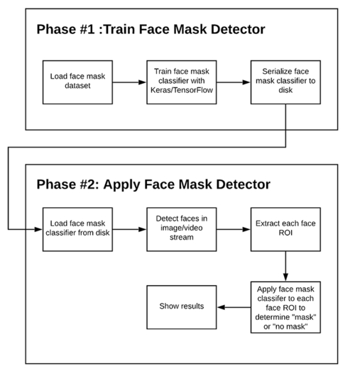
FLOW CHART OF FACEMASK DETECTION SYSTEM
Face Mask Detection System
November 11, 2024

Slide 7
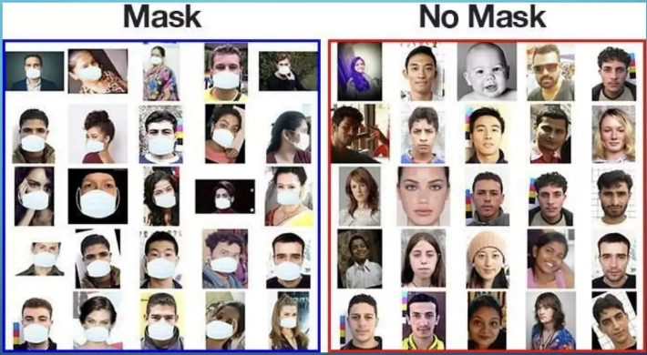
DATA SET:
The training dataset used here is a combination of images with and without masks, sourced from various assets such as Kaggle and the RMFD dataset. This dataset contains 2,155 images in the "with mask" category and 2,023 images in the "without mask" category, captured from different angles.
Face Mask Detection System
November 11, 2024

Slide 8
DEEP LEARNING MODELS THAT WE HAVE USED TO
FIND THE ACCURACY AND LOSS PERCENTAGE:
Sequential Model
Vgg16(Visual Geometric Group) Model
MobileNet Version 2
Face Mask Detection System
November 11, 2024

Slide 9
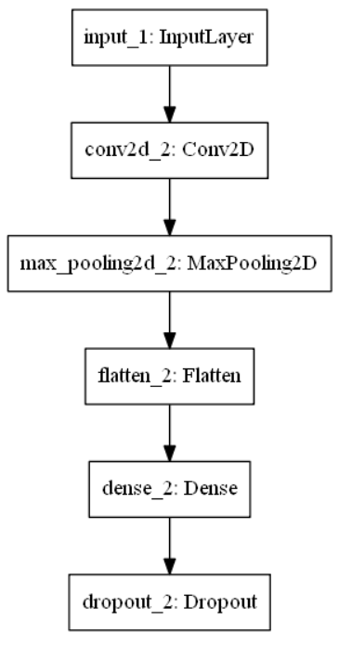
SEQUENTIAL MODEL
The Sequential CNN model is trained with 20 epochs which gives us training accuracy of 0.9899 with loss of 0.0346 beyond which the accuracy changes due to increased training time and based upon parameter values.
Fig. Sequential Model Architecture
Face Mask Detection System
November 11, 2024

Slide 10
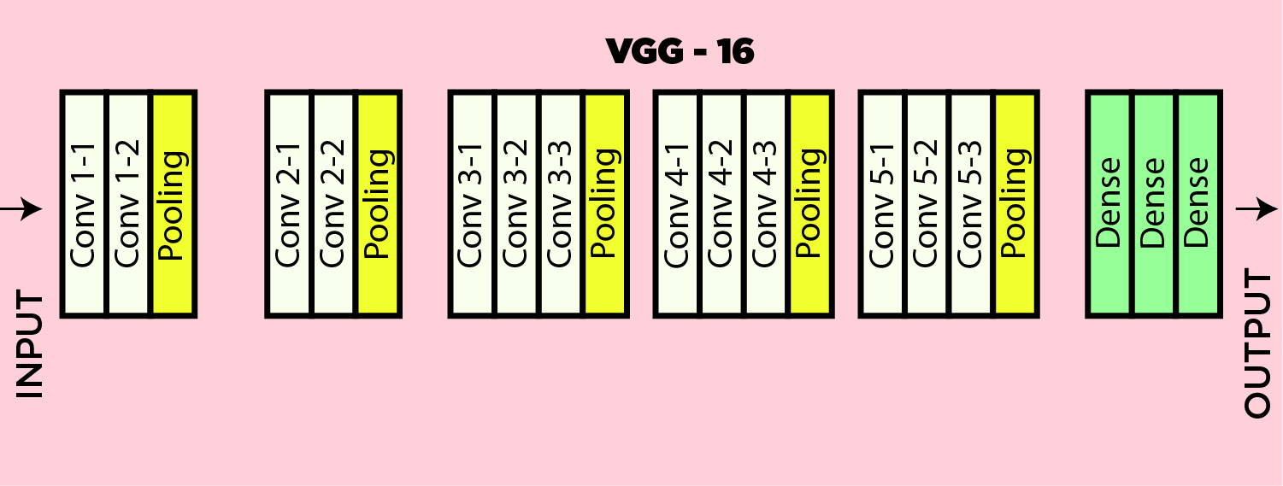
VGG-16 MODEL
Fig. VGG 16 Architecture
VGG-16 model is trained upon the training dataset and gives accuracy of 0.9427 with loss of 0.1436
Face Mask Detection System
November 11, 2024

Slide 11
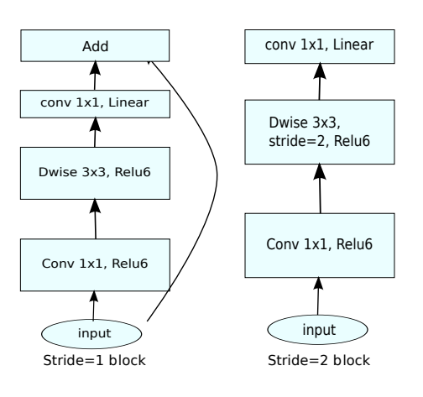
MOBILENET V2 MODEL
Fig. MobileNetV2 Architecture
Model is trained for 20 epochs and gives accuracy of 0.9922 with loss of 0.0282 for the training set .
Face Mask Detection System
November 11, 2024

Slide 12
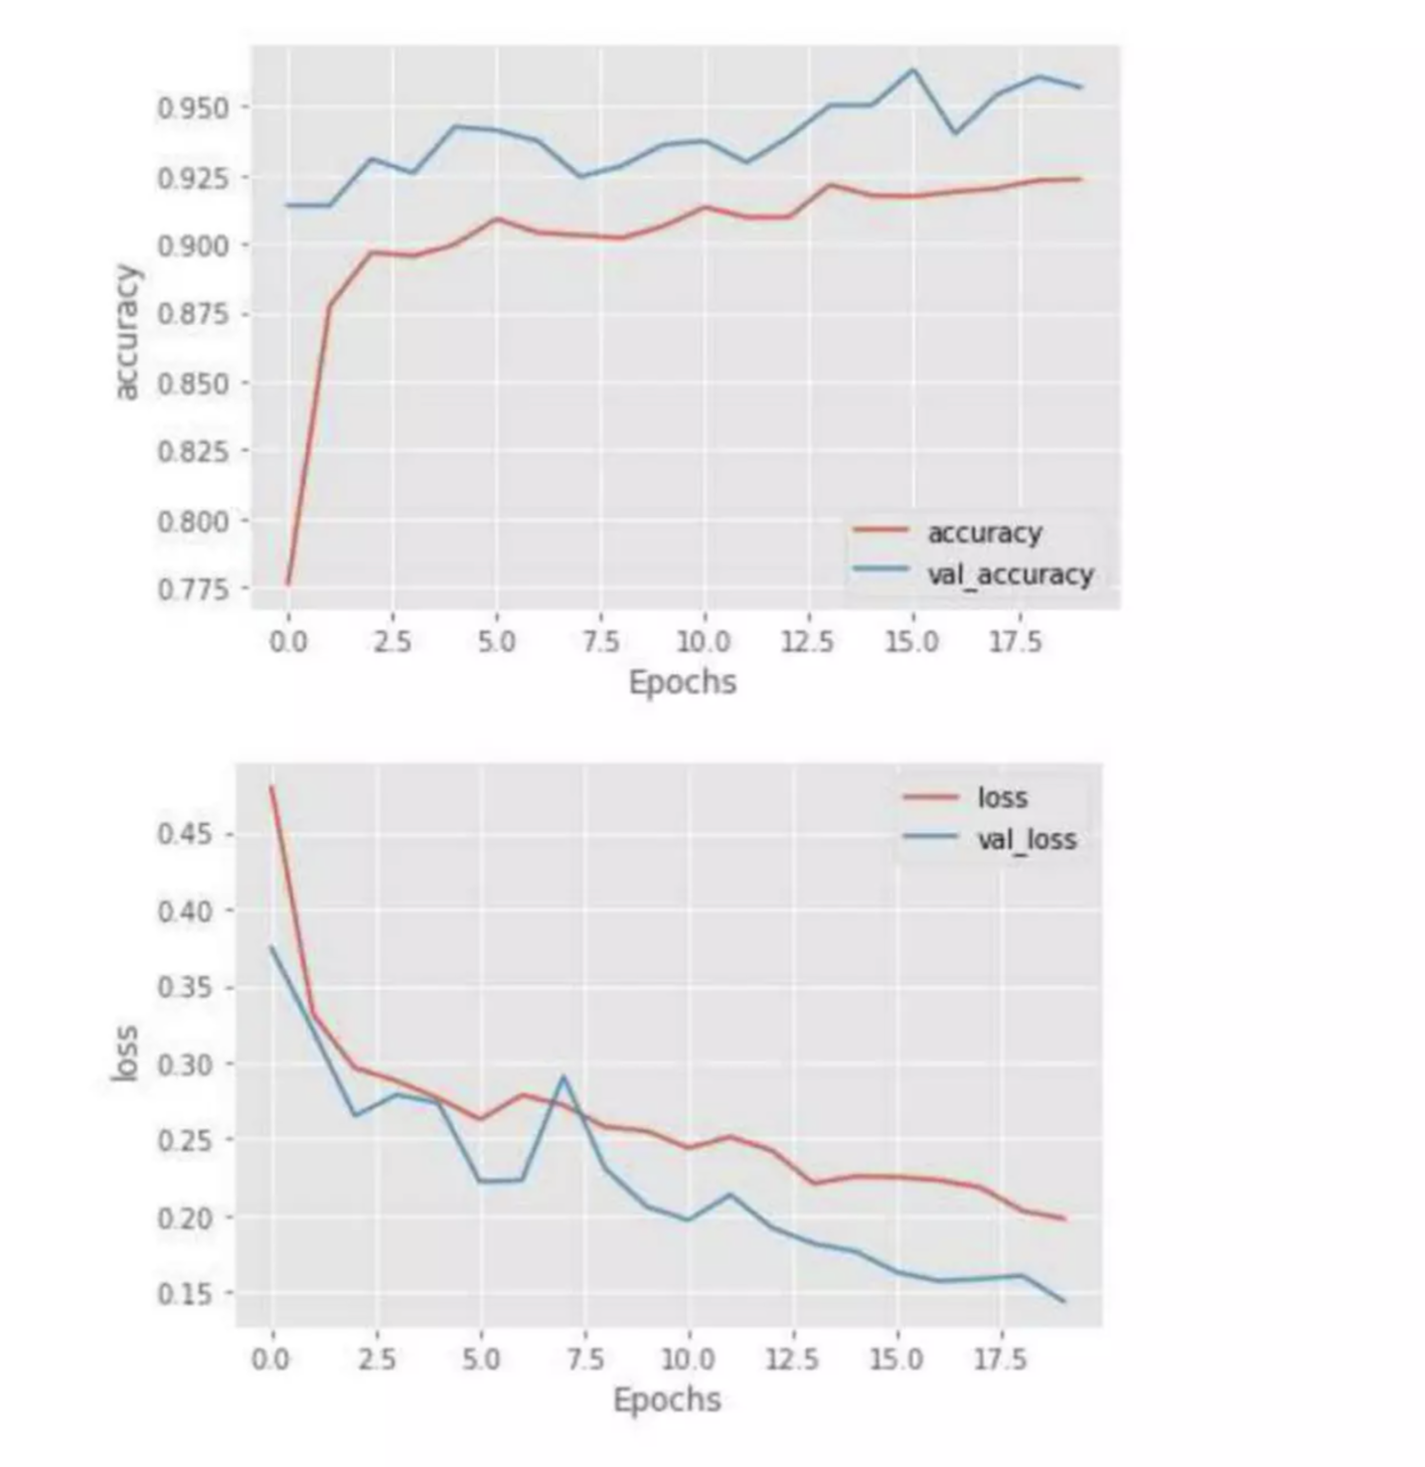
SEQUENTIAL MODEL ACCURACY AND EPOCHS
GRAPHS
Face Mask Detection System
November 11, 2024

Slide 13
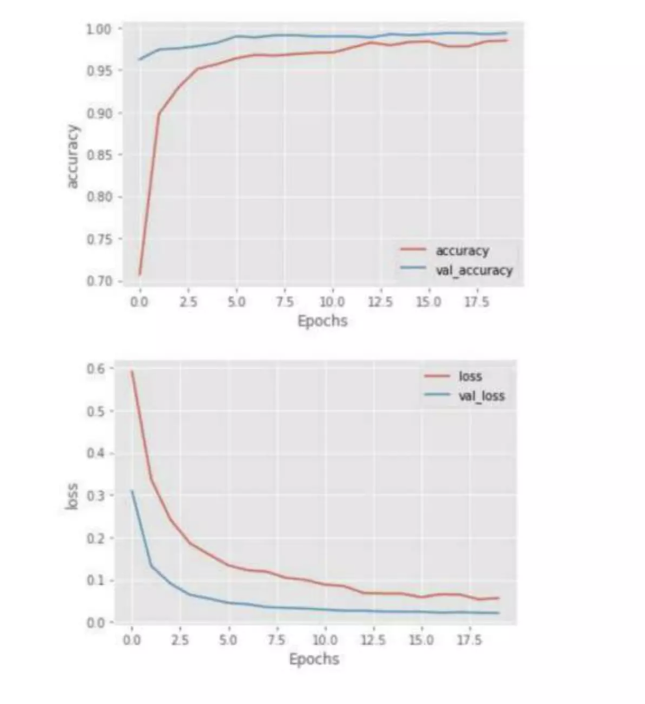
VGG16 MODEL ACCURACY AND EPOCHS
GRAPHS
Face Mask Detection System
November 11, 2024

Slide 14
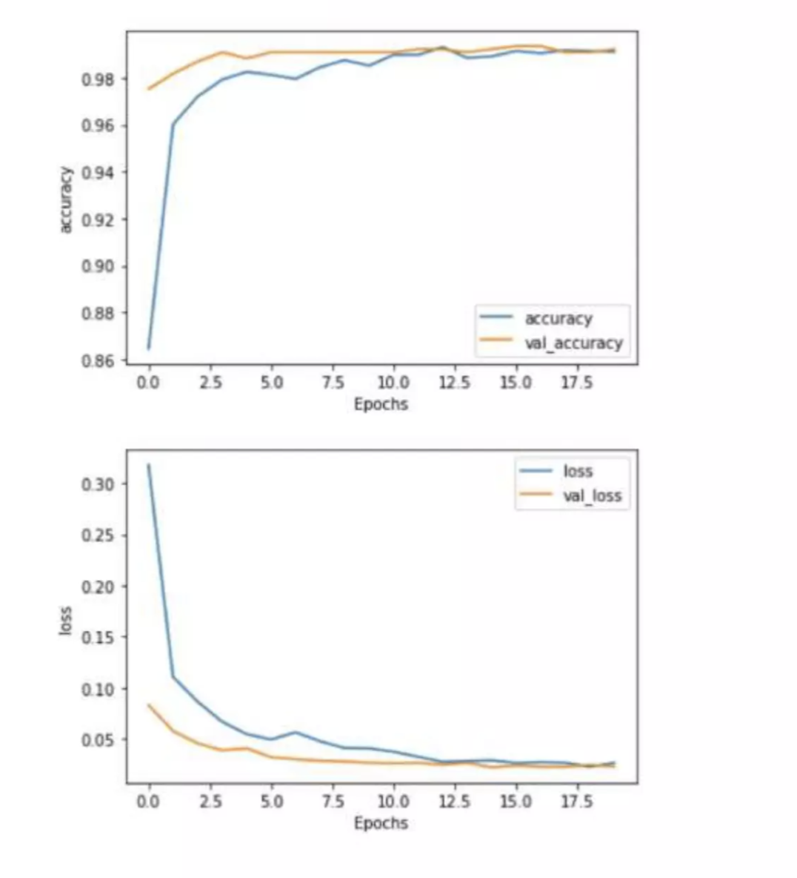
MOBILE NET V2 MODEL ACCURACY AND EPOCHS
GRAPHS
Face Mask Detection System
November 11, 2024

Slide 15
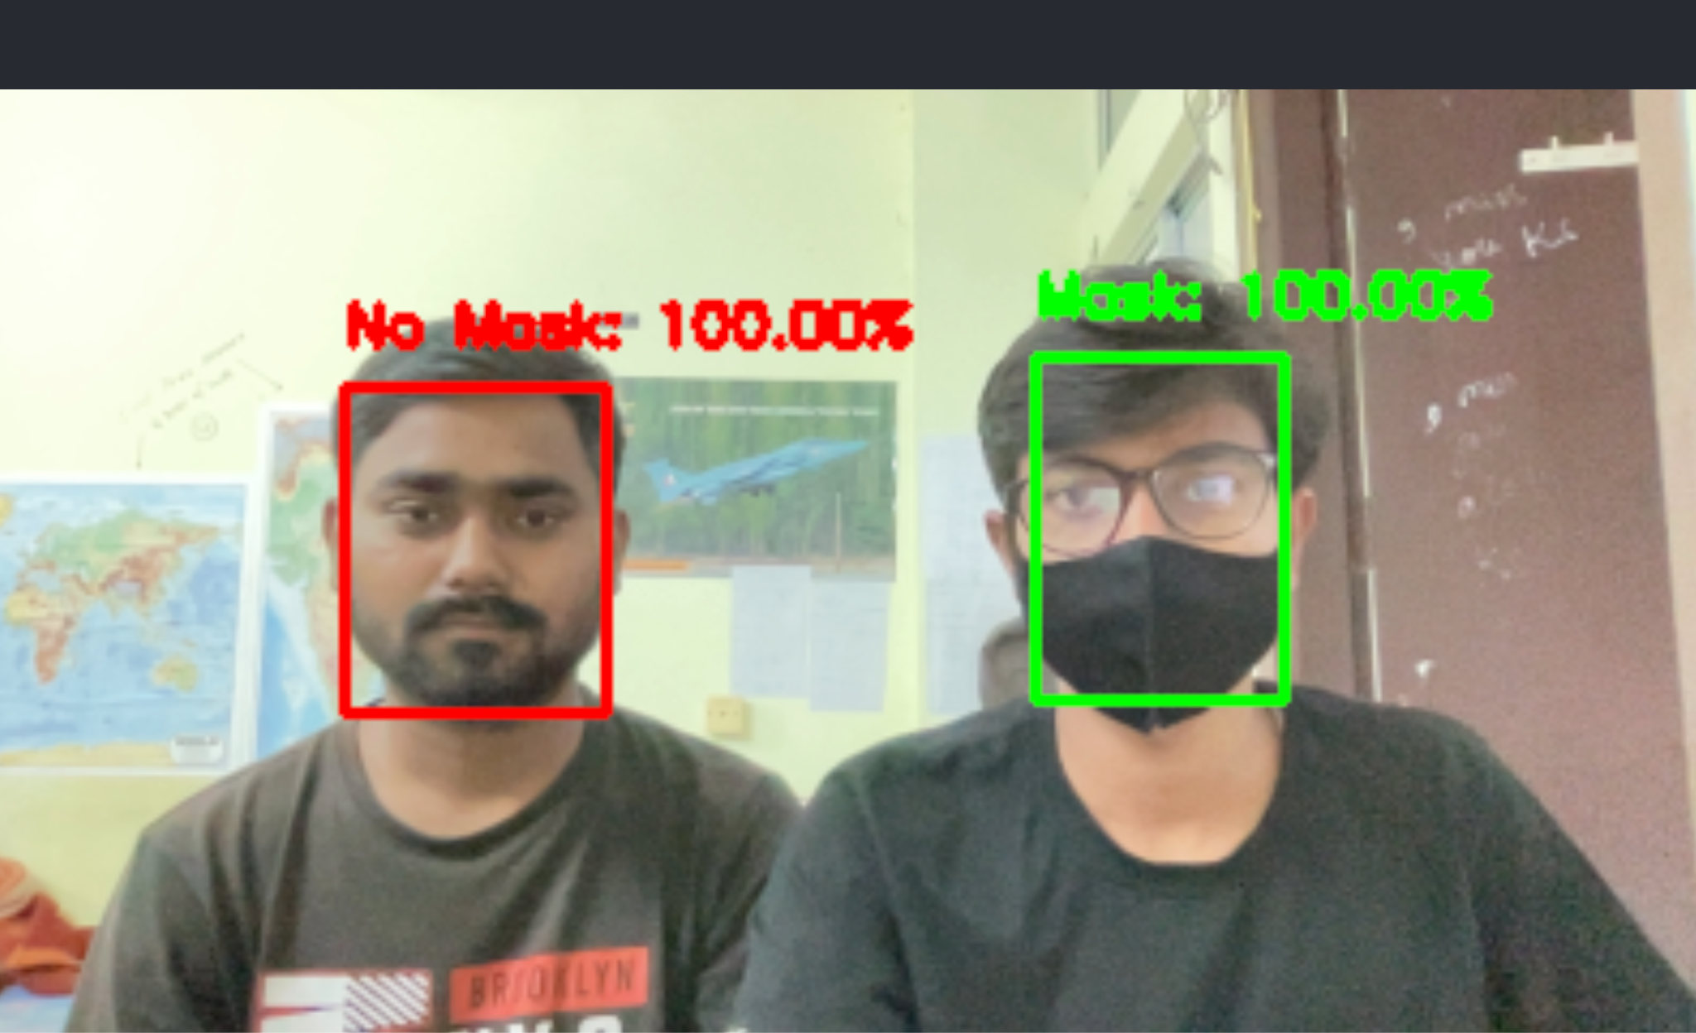
OUTPUTS OF OUR MODEL
Face Mask Detection System
November 11, 2024

Slide 16
EXPERIMENTAL RESULT
 | Wearing Mask Result(%) | No Mask Result(%)
MobileNet | Mask : 99.80 % | No Mask : 100 %
CNN | Mask : 97.55 % | No Mask : 90 %
Vgg 16 | Mask : 94.26 % | No Mask : 100 %
Face Mask Detection System
November 11, 2024

Slide 17
CONCLUSION
,
In this project, we created a face mask detector using OpenCV, Keras/TensorFlow, and deep learning.
To build the face mask detector, we trained a two-class model to identify people wearing masks and those not wearing masks.
The model was inferred on live video streams. To select a base model, we evaluated the metrics like accuracy, precision and recall and selected MobileNet architecture with the best performance having 99% accuracy
This face mask detector can be deployed in many areas like shopping malls, airports and other heavy trafﬁc places to monitor the public and to avoid the spread of the disease by checking who is following basic rules and who is not.
Face Mask Detection System
November 11, 2024

Slide 18
REFERENCES
,
Y. Liu, A. A. Gayle, A. Wilder-Smith, and J. Rocklöv "The reproductive number of COVID-19 is higher compared to SARS coronavirus," Journal of Travel Medicine, 2020.
Y. Fang, Y. Nie, and M. Penny "Transmission dynamics of the COVID-19 outbreak and effectiveness of government interventions: A data-driven analysis," Journal of Medical Virology, vol. 92, no. 6, pp. 645-659, 2020.
N. H. Leung, D. K. Chu, E. Y. Shiu, K.-H. Chan, J. J. McDevitt, B. J. Hau, H.-L. Yen, Y. Li, D. KM, J. Ip et al. "Respiratory virus shedding in exhaled breath and efficacy of face masks."
S. Feng, C. Shen, N. Xia, W. Song, M. Fan, and B. J. Cowling "Rational use of face masks in the COVID-19 pandemic," The Lancet Respiratory Medicine, 2020.
Face Mask Detection System
November 11, 2024

Slide 19
Thank you
Face Mask Detection System
November 11, 2024

